Slide 1
‘Information extraction from
ancient epigraphs
using
Digital image processing’
By:
Anisha Suri
Maitreyi Gupta
Tanya Adlakha
B.Tech. ECE 7th Sem

Slide 2
OBJECTIVE:
To enhance the quality of textual information from ancient epigraphs for better human perception and also to transform into computer recognizable form for preservation.

Slide 3
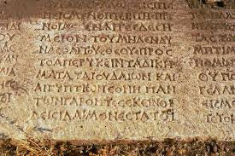
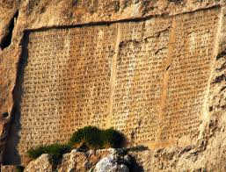
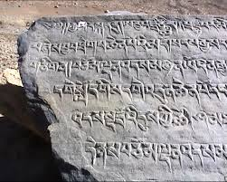
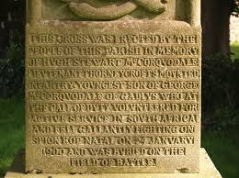
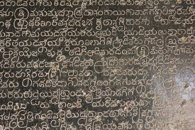

Slide 4
ANALYSIS OF PROBLEM
The quality of ancient epigraphs, which are still available for reference today and preserved by libraries and universities all around the world, is poor due to physical deterioration.
The deterioration processes often result in uneven background coloration across the image and the darkening of the background which reduces the contrast between the foreground text and the background color of the documents.
The problem is introduced during the conversion of manuscripts to their digital image form.

Slide 5
SOLUTION
Digital image processing techniques are necessary to improve the legibility of the historical inscriptions.
Pre-processing is aimed at removing the background noise of ancient degraded documents.
The proposed methodology performs the improvement in the quality of historical manuscripts having uneven background and low contrast due to the traditional mode of manufacture and the effect of ageing and degradation.

Slide 6
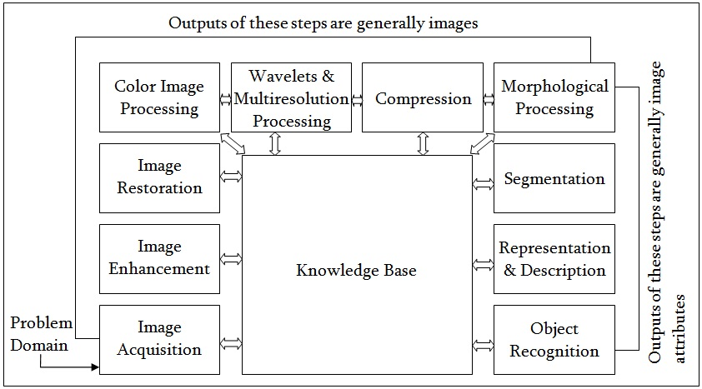
Fundamental Steps in Digital Image Processing

Slide 7
Fundamental steps in Image Processing:
1. Image Acquisition: The image is captured by a sensor and digitized.
2.Image Enhancement: The process of manipulating an image so that the result is more suitable than the original for specific applications.
3.Image Restoration: Improving the appearance of the image.
4. Color Image Processing: Use the color of the image to extract features of interest in an image.
5. Wavelets: Used in image data compression and pyramidal representation.
6. Compression: For reducing the storage required to save an image.

Slide 8
Fundamental steps in Image Processing:
7. Morphological Processing: The tools for extracting image' components that are useful in the representation and description of shape.
8. Image Segmentation: Computer tries to separate objects from the image background.
9. Representation: It makes a decision whether the data should be represented as a boundary or as a complete region.
10. Recognition / Interpretation: Recognition is the process that assigns label to an object based on the information provided by its descriptors.

Slide 9
System Architecture for Pre-processing of the Epigraphs
Input :
Ancient
Epigraphical
image
Spatial Filtering and Image Enhancement
Binarization
Output Binary Image

Slide 10
PROPOSED ARCHITECTURE:
Input :
Ancient
Epigraphical
image
Gaussian Blurring
Window Size:[3X3]
Standard Deviation:0.7
Binarization
Using Otsu’s Method
Output Binary Image
Post Processing
By Applying Erosion

Slide 11
The steps towards Preprocessing of Ancient Epigraphs are as follows:
Step 1: [Read Image]: Read epigraphical image selected as input.
Step 2: [Gray Conversion]: The input image is converted into gray scale image.
Step 3: [Enhancement]: The input ancient epigraph of poor quality and varying amount of degradation is enhanced using any of the following filtering methods, designed and implemented with different mask sizes, depending whether smoothing or sharpening is the requirement, for better human perception.
Step 4: [Binarize]: A threshold is determined for the conversion. The grayscale image is then converted to binary image consisting of ones and zeros.
Step 5: [Display] : The enhanced binary image is displayed.

Slide 12
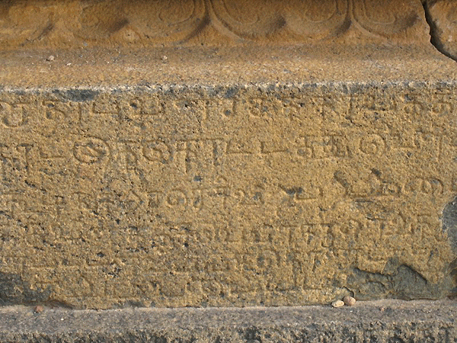
Test Image 1
Type of file: JPG File (.jpg)
Size: 434,111 bytes
Dimensions: 450x600
Bit depth: 24
Source: Epigraph Situated on a
shrine in Tirumukkudal
near Kanchipuram

Slide 13
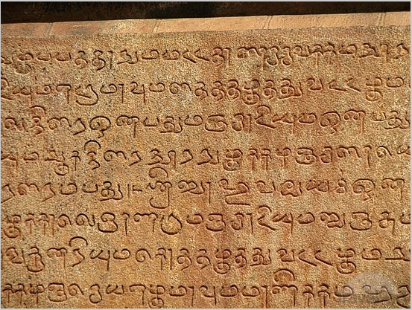
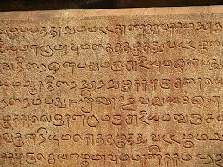
Test Image 2
Type of file: JPG File (.jpg)
Size: 237,491 bytes
Dimensions: 413x550
Bit depth: 24
Source: Located in Tanjore of
Tamil Nadu on the
Kaveri River delta.

Slide 14
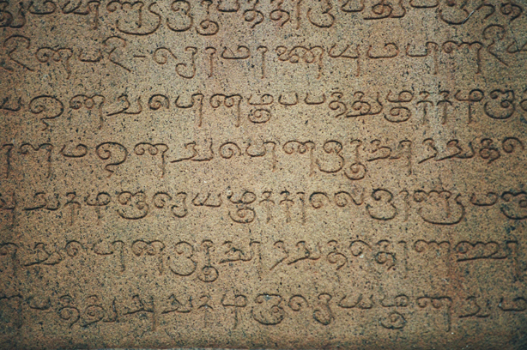
Test Image 3
Type of file: PNG File (.png)
Size: 577,359 bytes
Dimensions: 408x614
Bit depth: 24
Source: Kumari Kandam
Tamil Script

Slide 15
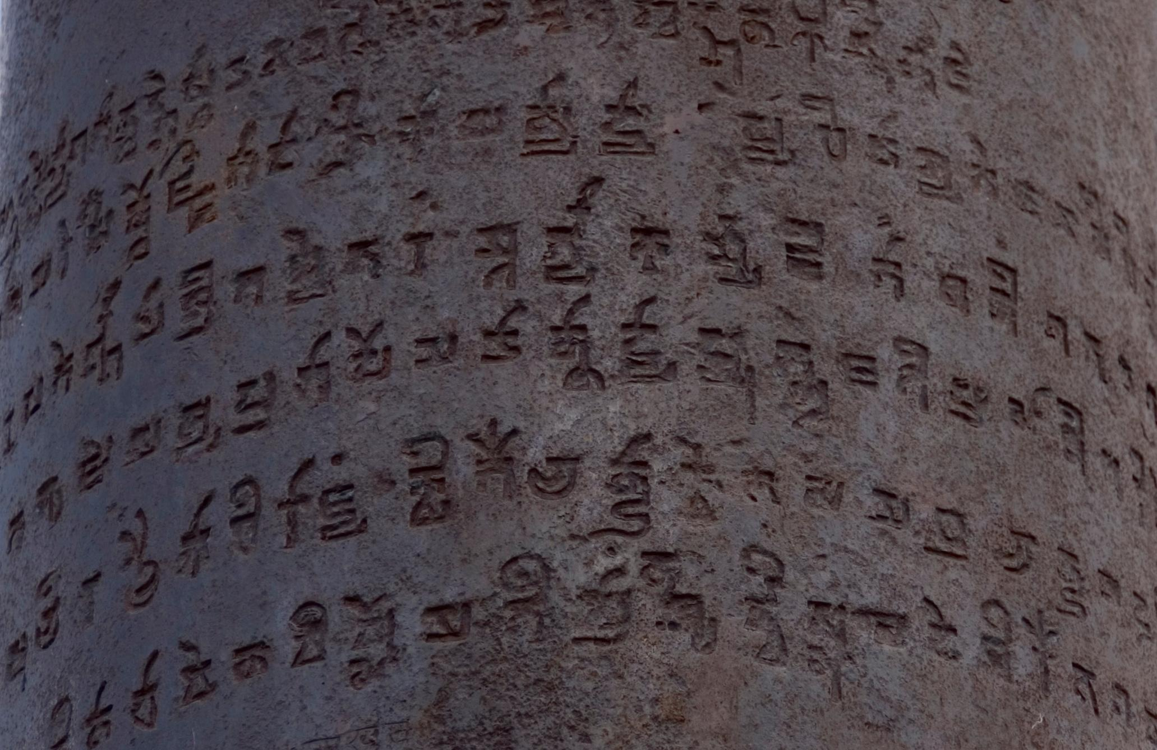
Test Image 4
Type of file: JPG File (.jpg)
Size: 73399 bytes
Dimensions: 375x500
Bit depth: 24
Source: Ashoka Pillar at
Qutab Minar

Slide 16
GRAY IMAGE
Conversion of a color (RGB) image to gray scale image is due to the following reasons: :
Simplicity - Many image processing operations work on a plane of image data at a time. Gray scale images only contain one image plane (containing the gray scale intensity values).
Data reduction - A gray scale would need to process only 1/3 of the data compared to the original color image.
Reading image and converting to gray
CODE SCRIPT:
imread('epigraph 1.jpg') original=imread('epigraph 1.jpg') gray=rgb2gray(original)
norgray=double(gray)/255

Slide 17
IMAGE ENHANCEMENT
Smoothing Techniques:
Smoothing filters are used for blurring and for noise reduction. Blurring is used in preprocessing steps, such as removal of small details from an image prior to object extraction, and bridging of small gaps in lines or curves. Noise reduction can be accomplished by blurring with a linear filter and also by non-linear filtering.
Smoothing Linear Filters
The output of a smoothing, linear spatial filter, also called averaging filters, is simply the average of the pixels contained in the neighborhood of the filter mask.
Mean Filter:
It replaces each pixel value in an image with the mean value of its neighbors, including itself. 
This has the effect of reducing the noise in an image by eliminating pixel values which are unrepresentative of their surroundings.
It flattens local differences and reduces sharpness thereby blurring the details and edges.
Disk Filter:
It is a simple circular averaging filter where the radius controls how big an area the operator should locate when spreading pixels.

Slide 18
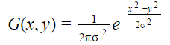
IMAGE ENHANCEMENT
Order-Statistics Filters
Order-statistics filters are nonlinear spatial filters whose response is based on ordering the pixels contained in the image area encompassed by the filter, and then replacing the value of the center pixel with the value determined by the ranking result.
Median Filter:
Performs a nonlinear operation which replaces each entry with the median of its neighbouring entries.
Reduces impulse or salt and pepper noise and can smooth pixels whose values differ significantly from their surroundings.
Gaussian Filter:
The Gaussian smoothing operator is a 2-D convolution operator that is used to `blur' images and remove detail and noise.
It is similar to the mean filter but it uses a different kernel that represents the shape of a Gaussian hump.
This formula produces a surface whose contours are concentric circles with a gaussian distribution from the centre point which is used to build a convolution matrix which is applied to the original image.

Slide 19
MATLAB Code listing:
This is the common function that we created to implement the various smoothing filters.
function[ngauss, nmean, nmedian, ndisk]=smoothing(norgray, masksize, sd, radius)
gaussf = fspecial('gaussian', [masksize masksize], sd);
ngauss = imfilter(norgray,gaussf);
nmedian = medfilt2(norgray,[masksize masksize]);
meanf = fspecial('average', masksize);
nmean = imfilter(norgray,meanf);
diskf = fspecial('disk',radius);
ndisk = imfilter(norgray,diskf);

Slide 20
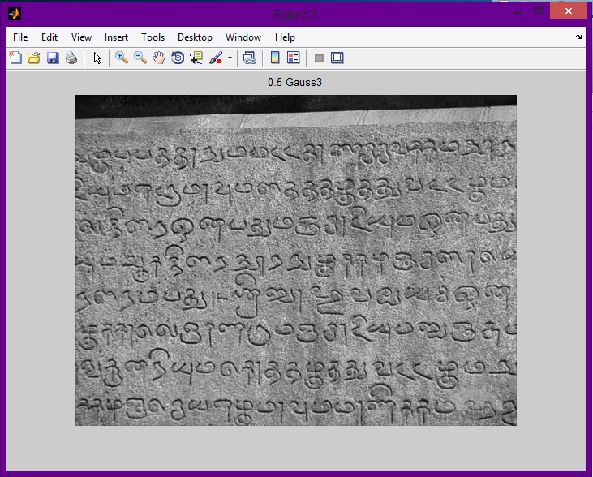
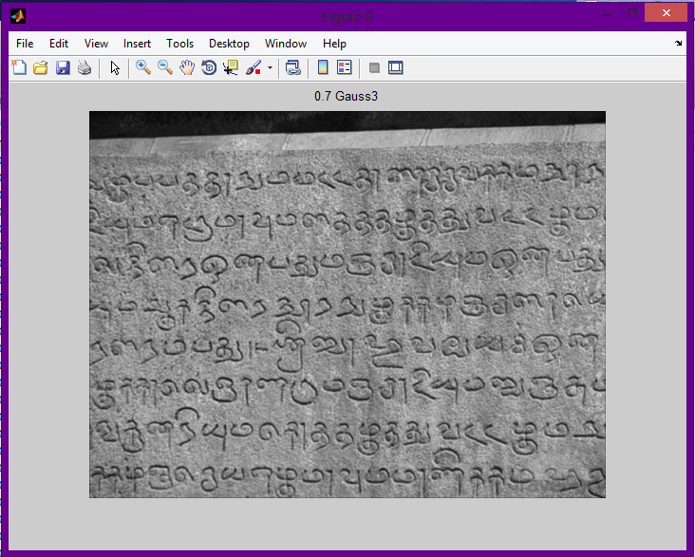
Gaussian σ = 0.5 3x3 Gaussian σ = 0.7
PSNR= 76.5864 LMSE= 0.1787 PSNR= 71.4244 LMSE= 0.5342

Slide 21
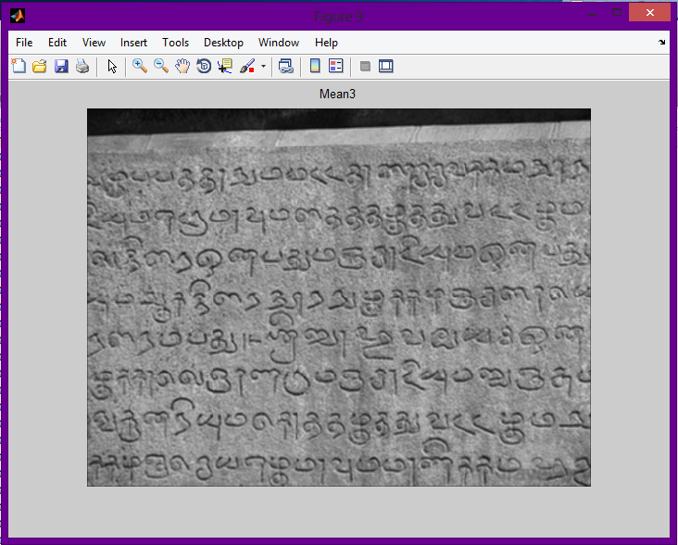
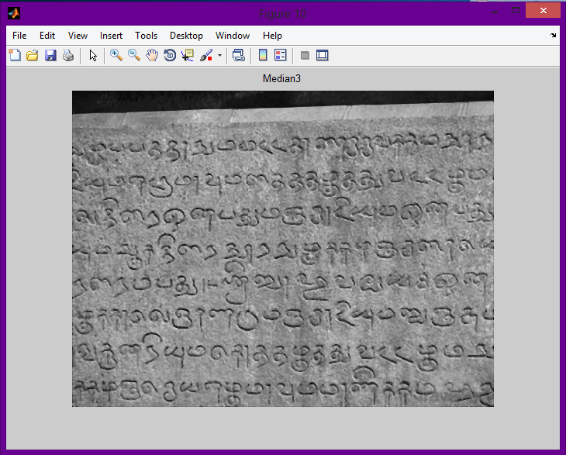
Mean 3x3 Median 3x3
PSNR= 73.4331 LMSE= 0.9282 PSNR= 73.9377 LMSE= 0.8668

Slide 22
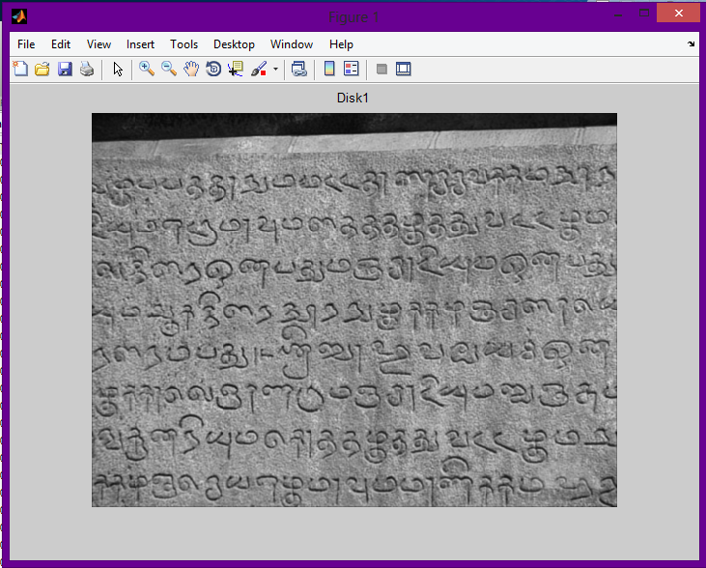
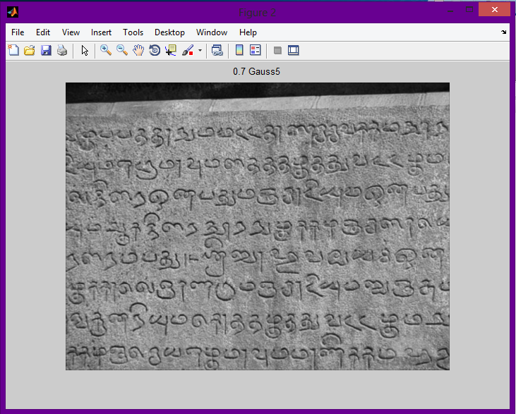
Disk radius = 1 5x5 Gaussian σ = 0.7
PSNR= 76.5148 LMSE= 0.5887 PSNR= 71.1271 LMSE= 0.5516

Slide 23
IMAGE ENHANCEMENT
Sharpening Techniques:
The principal objective of sharpening is to highlight fine detail in an image or to enhance detail that has been blurred.
Sharpening deals with digital differentiation in spatial domain.
Sharpening Spatial Filters
The strength of the response of a derivative operator is proportional to the degree of discontinuity of the image at the point at which the operator is applied.
Image differentiation enhances edges and other discontinuities (such as noise) and deemphasizes areas with slowly varying gray-level values.

Slide 24
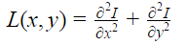
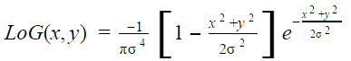
IMAGE ENHANCEMENT
Laplacian Filter:
The Laplacian L(x,y) of an image with pixel intensity values I(x,y) is given by:
This can be calculated using a convolution filter.
Using one of the following kernels, the Laplacian can be calculated using standard convolution methods.
LoG Filter:
Laplacian filters are derivative filters used to find areas of rapid change in images.
Since derivative filters are very sensitive to noise, it is common to smooth the image (e.g., using a Gaussian filter) before applying the Laplacian.
This two-step process is call the Laplacian of Gaussian (LoG) operation.
Two commonly used small kernels.
0 | -1 | 0 |  | -1 | -1 | -1
-1 | 4 | -1 |  | -1 | 8 | -1
0 | -1 | 0 |  | -1 | -1 | -1

Slide 25
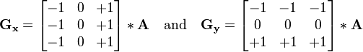
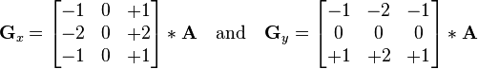
IMAGE ENHANCEMENT
Prewitt Filter:
The Prewitt operator is a discrete differentiation operator, computing an approximation of the gradient of the image intensity function. 
At each point in the image, the result of the prewitt operator is corresponding gradient vector. 
The operator is based on convolving the image with small separable and integer valued filter in horizontal and vertical direction.
Sobel Filter:
The Sobel operator is a discrete differentiation operator, computing an approximation of the gradient of the image intensity function.
It is based on convolving the image with a small, separable and integer valued filter in the horizontal and vertical direction.
The final step involves approximating the gradient magnitude.

Slide 26
MATLAB Code listing:
This is the common function that we created to implement the various sharpening filters.
function[modlog,modlap,modprew,modsob] = sharpening(norgray,masksize,sd,alpha)
laplcf = fspecial('laplacian',alpha);
modlap1 = imfilter(norgray,laplcf);
modlap = double((modlap1+1)/2);
logf = fspecial('log',masksize, sd);
modlog1 = imfilter(norgray,logf);
modlog =double((modlog1+1)/2);
prewf = fspecial('prewitt');
modprew1 = imfilter(norgray,prewf);
modprew = double((modprew1+1)/2);
sobelf = fspecial('sobel');
modsob1 = imfilter(norgray,sobelf);
modsob = double((modsob1+1)/2);

Slide 27
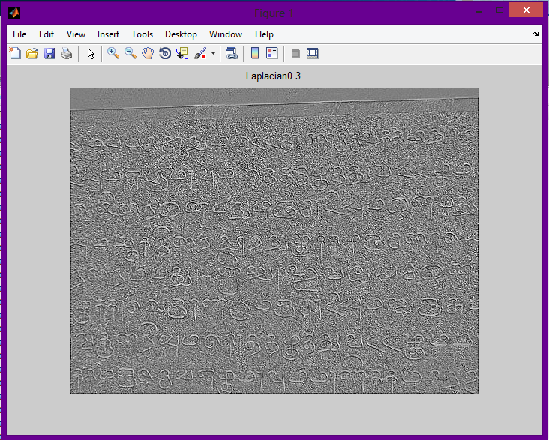
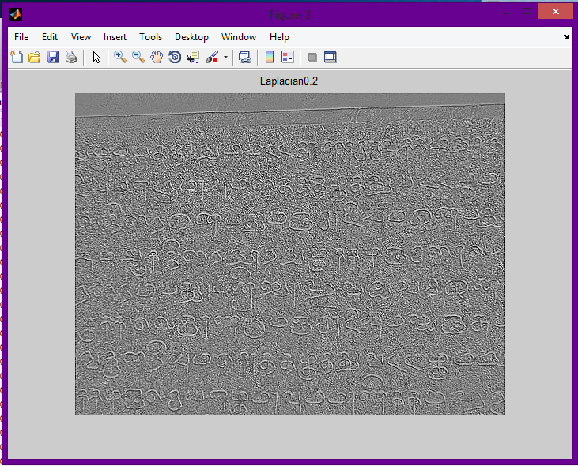
Laplacian α=0.3 Laplacian α=0.2
PSNR= 58.3166 LMSE=7.1614 PSNR=58.1241 LMSE=7.9352

Slide 28
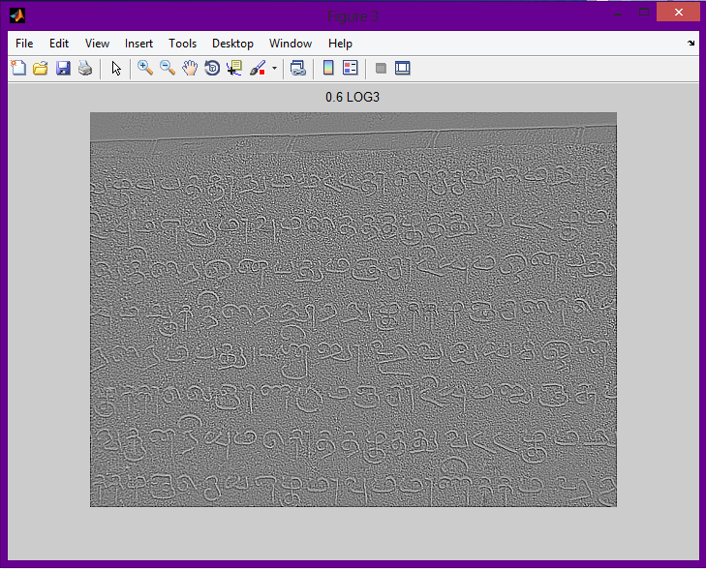
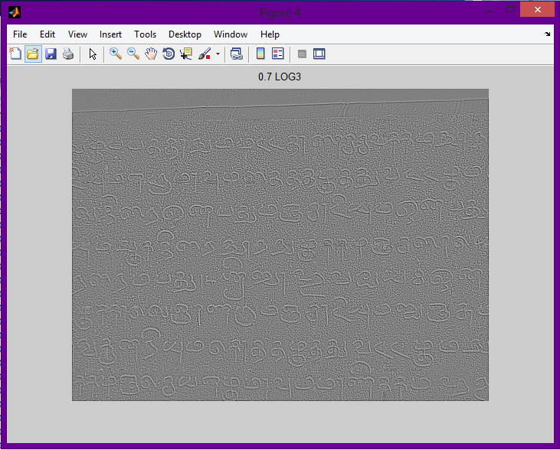
LoG σ = 0.6 LoG σ = 0.7
PSNR= 58.7373 LMSE= 5.4484 PSNR=60.1755 LMSE=3.0027

Slide 29
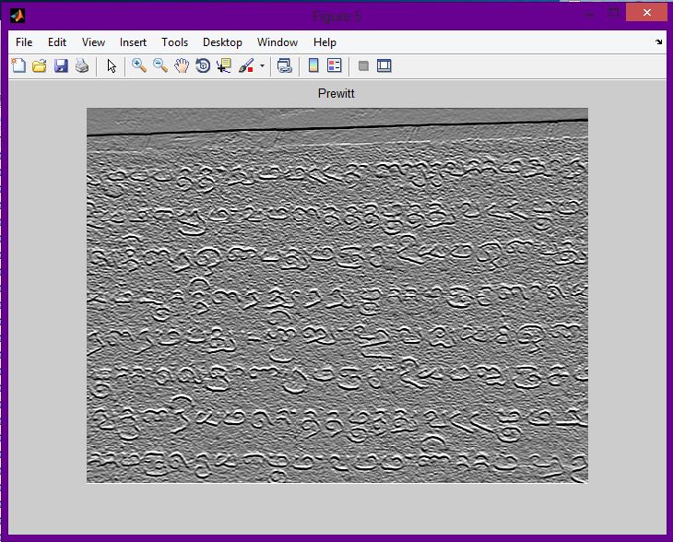
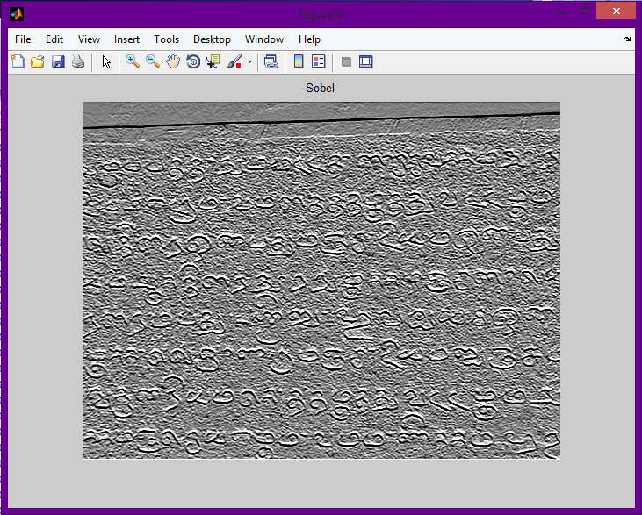
Prewitt Filter Sobel Filter
PSNR= 58.5468 LMSE= 2.8322 PSNR= 56.4878 LMSE= 4.8289

Slide 30
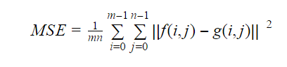
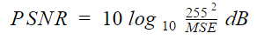
Image Quality Measures:
Image quality is a characteristic of an image that measures the perceived image degradation (compared to an ideal or perfect image). Imaging systems may introduce some amounts of distortion or artifacts in the signal, so the quality assessment is an important problem. Following image quality parameters are calculated for the test images:
Mean Squared Error (MSE): The mean squared error (MSE) of an estimator measures the average of the squares of the "errors", that is, the difference between the estimator and what is estimated. Lower the value of MSE, better is the image quality. MSE is defined as follows:
Peak Signal to Noise Ratio (PSNR): Peak signal-to-noise ratio (PSNR) is the ratio between the maximum possible power of a signal and the power of corrupting noise that affects the fidelity of its representation. A larger value of PSNR defines better image quality. PSNR is defined as follows:

Slide 31
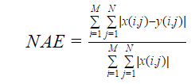
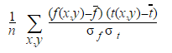
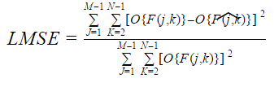
Normalized Absolute Error (NAE): A smaller value of Normalized Absolute Error (NAE) defines a better image quality. NAE is defined as follows:
Laplacian Mean Square Error (LMSE): Laplacian Mean Square Error (LMSE) is based on the importance of edges measurement. Lower the value of LMSE, better is the image quality. LMSE is defined as follows:
Normalized Cross-Correlation (NK): For image-processing applications in which the brightness of the image and template can vary due to lighting and exposure conditions, the images can be first normalized. The cross-correlation of a template, t(x,y) with a sub-image f(x,y) is
where n is the number of pixels in t(x,y) and f(x,y), f is the average of f and σ_{f} is standard deviation of f.

Slide 32
MATLAB Code listing:
This is the common function that we created to implement the various sharpening filters.
for i=1:size_x
for j=1:size_y
sum1=sum1+power((double_filtered(i,j)-double_original(i,j)),2);
end
end
sum1=double(sum1);
% size(sum);
no_of_pixels=double(size_x*size_y);
% size(no_of_pixels);
MSE1=double(sum1/no_of_pixels);
psnr_calculation=double(power(255,2)/MSE1);
psnr_in_db=double(10*log10(psnr_calculation));
PSNR1=double(psnr_in_db)
function [MSE1,PSNR1,NAE,LMSE,NK]=
quality_measures(original,filtered)
original=double(original);
filtered=double(filtered);
R=double(original)-double(filtered);
NAE=double(sum(sum(abs(R)))/sum(sum(abs(double(original)))));
OP=4*del2(original);
LMSE=double(sum(sum((OP-4*del2(filtered)).^2))/sum(sum(OP.^2)));
Pk=sum(sum(original.^2));
NK=double(sum(sum(original.*filtered))/Pk);
size_x,size_y]=size(original);
sum1=0;
double_original=double(original);
double_filtered=double(filtered);

Slide 33
BINARIZATION
Binary images:
Only two different intensity or pixel values.
Requires less storage space and less processing time.
Application areas : optical character recognition, Object recognition, face recognition, image segmentation, scene analysis etc.
Binarization:
Representing an image using only two different pixel values.
Threshold value: Those pixel values greater than or equal to the threshold is set to a particular grey value and those below the threshold to another grey value.
Thresholding determines the quality of the binary image. There are various methods to find the threshold value.

Slide 34
OTSU’s METHOD
In Otsu's method, the threshold that minimizes the intra-class variance (the variance within the class) is searched. Intra-class variance is defined as a weighted sum of variances of the two classes:
Weights w_{i} are the probabilities of the two classes separated by a threshold t and σ_{i} are variances of these classes. Otsu shows that minimizing the intra-class variance is the same as maximizing inter-class variance.
The Otsu method produces a threshold on the 0:1 scale. This threshold applies to the dynamic range of pixel intensities present in the image.
σ_{w}²(t) = w₁(t) σ²₁(t) + w₂(t) σ²₂(t)

Slide 35
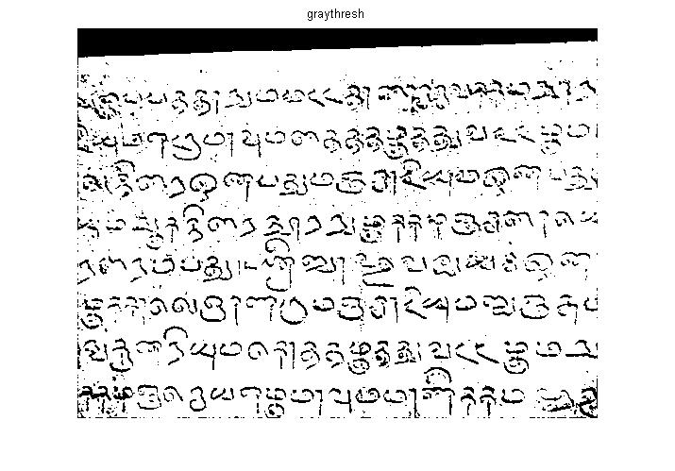

IMPLEMENTATION OF OTSU’S METHOD
Code Script: Code Script:
>>level=graythresh(gauss1); >>level=multithresh(gauss1); >>BW = im2bw(gauss1,level); >>BW = im2bw(gauss1,level); >>imshow(BW) >>imshow(BW)

Slide 36
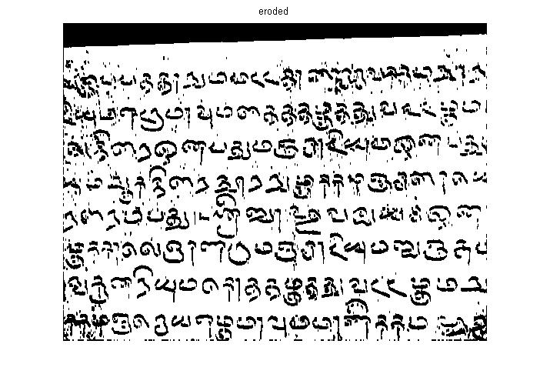
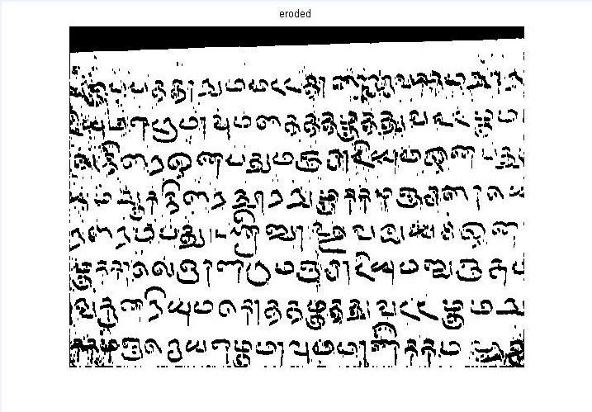
After Applying Erosion to Graythresh and Multithresh
Code Script:
>>ero=imerode(BW,nb);
>>figure;
>>imshow(ero);
>>title('eroded');
Code Script:
>>erm=imerode(BW,nb);
>>figure;
>>imshow(erm);
>>title('eroded');

Slide 37
NIBLACK’S ALGORITHM
Calculates pixel-wise threshold by sliding a rectangular window over the gray-level image.
Adapts the threshold according to the local mean m(i, j) and standard deviation σ(i, j) and calculated a window size of b × b
The threshold T is denoted as: T(i, j) = m(i, j) + k · σ(i, j).
Here, k is a constant, which determines how much of the total print object edge is retained, and has
a value between 0 and 1.
The size of the neighborhood should be small enough to reflect the local illumination level and large enough to include both objects and the background.

Slide 38
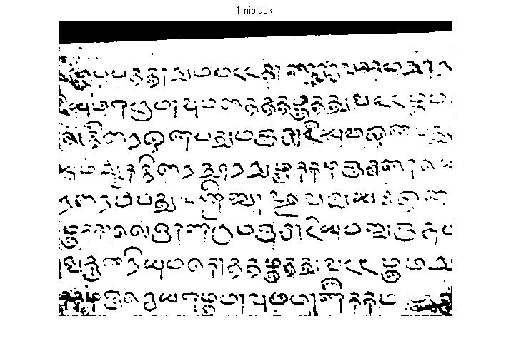
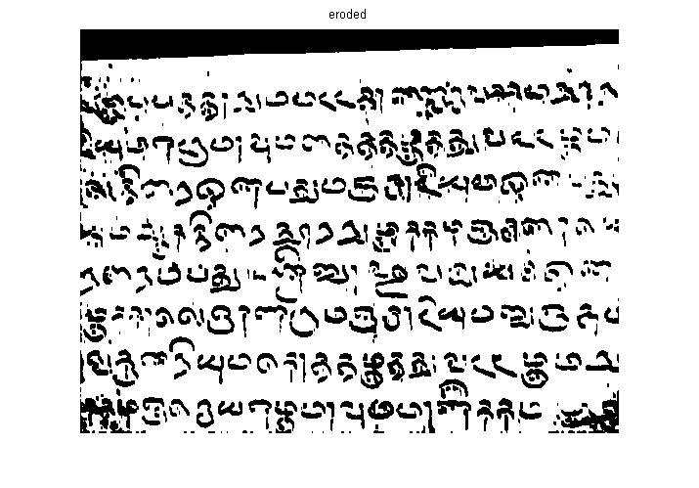
IMPLEMENTATION OF NIBLACK’S METHOD
Code Script:
n=niblack(gauss1);
figure;
imshow(n);
title('niblack');
n1=1-n;
ern=imerode(n1,nb);
figure;
imshow(ern);
title('eroded');

Slide 39
SAUVOLA’S ALGORITHM
.
A local-variance-based method
Improvement on the method proposed by Niblack especially when the background contains light texture, big variations, stained and badly and unevenly illuminated documents
The threshold is calculated as follows:
T(i, j) = m(i, j) ∗σ(i, j)(1 + k/(R − 1))
k is a constant, which determines how much of the total print object edge is retained, and has a value between 0 and 1
An optimal combination of k and the sliding window will produce a good binary image.

Slide 40
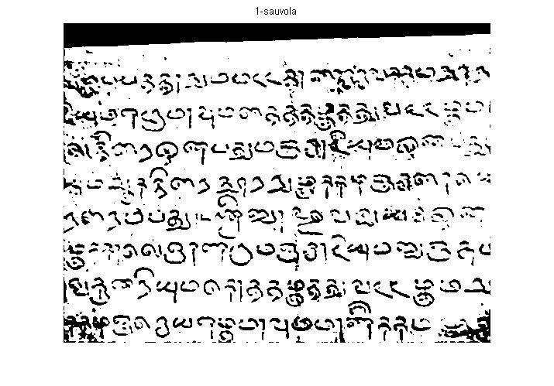
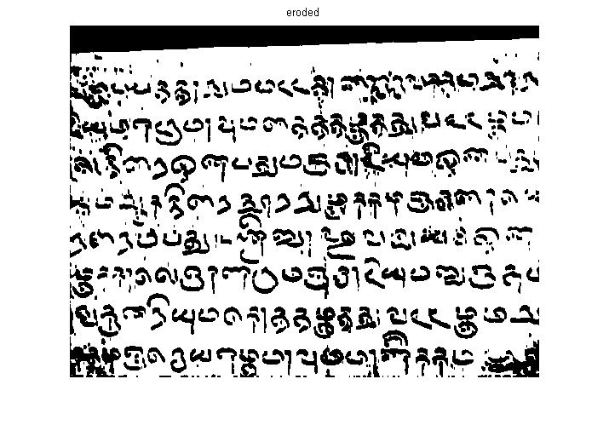
IMPLEMENTATION OF SAUVOLA’S METHOD
Code Script:
s=sauvola(gauss1);
figure;
imshow(s);
title('sauvola');
s1=1-s;
ers=imerode(s1,nb);
figure;
imshow(ers);
title('eroded');

Slide 41
CONCLUSIONS :
By comparing the performance of all Enhancement filters using the Quality measures MSE, PSNR, NAE, LMSE and NK , It was found that Blurring by using the Gaussian Filter gives the best results, as also repeatedly proved by the researchers whose paper we have referred.
2. As far as the ancient epigraphs is concerned, Gaussian filter with Mask size [3x3], SD=0.7 and Mean=0 is giving the best results.
3. By observing values of the quality measures as compiled in Appendix A, it is found that as we go on increasing the standard deviation in the Gaussian Filter, At a particular value for standard deviation (which varied for each of the sample taken) , It starts behaving as a mean filter. That is the values of all quality parameters for gaussian filter in this case are matched with the values as obtained in case of mean filter. Click here

Slide 42
4. For the image types that we are using, that is, ancient epigraphs and transcriptions,
it is found that PSNR is best parameter which can be used to compare filter
performance. The other parameters are not able to give precise values for
comparison in our case.
5. The priority that we can assign to the quality measures can be in the order:
MSE <NK < NAE < LMSE <PSNR
6. Otsu’s Algorithm, using Multi-thresholds is the best for Binarization of the Image.
The results obtained after applying Erosion to it appear least noisy.

Slide 43
Future Work
Segmentation and Optical Character Recognition:
Understanding the segmentation part will lead us one step closer to the Optical Character Recognition. Using Segmentation in this project will help us to distinguish among the various characters in the epigraphical image and hence the information on the image can be easily stored in a computer and subject to our utility.
Image Processing Techniques in the Wavelet Domain
Also, we have not yet explored the Wavelet domain in Image Processing. The various techniques of Binarization in the Wavelet domain are thus, yet to be explored.

Slide 44
REFERENCES :
K. Kaviya Selvi and R. S. Sabeenian,”RESTORATION OF DEGRADED DOCUMENTS USING IMAGE BINARIZATION TECHNIQUE,” ARPN Journal of Engineering and Applied Sciences,VOL. 10, NO. 7, APRIL 2015
Rafael C Gonzalez, “Digital Image Processing”, TATA McGraw Hill, Edition 2.
N. Chaki et al., “A Comprehensive Survey on Image Binarization Techniques,” Exploring Image Binarization Techniques, Studies in Computational Intelligence 560, DOI: 10.1007/978-81-322-1907-1_2, © Springer India 2014 http://www.springer.com/978-81-322-1906-4
Dejee Singh and R. K. Sahu, “Analysis of Quality Measurement Parameters of Deblurred Images,” International Journal of Advanced Research in Electrical, Electronics and Instrumentation Engineering (An ISO 3297: 2007 Certified Organization), Vol. 3, Issue 10, October 2014
Soumya , G Hemantha Kumar, “Preprocessing of Camera Captured Inscriptions and Segmentation of Handwritten Kannada text,”International Journal of Advanced Research in Computer and Communication Engineering, Vol. 3, Issue 5, May 2014

Slide 45
6. S.S. Bedi Rati Khandelwal,“International Journal of Advanced Research in Computer and
Communication Engineering,” Vol. 2, Issue 3, March 2013 Various Image Enhancement Techniques- A
Critical Review
7. Rishi Pandey, N. jayanthi, Geetanjali Bhola and Santanu Chaudhury, “Enhancement of Inscription
Images,” Indu Sreedevi, Electrical Engineering Department, IIT Delhi, India (2013)
8. Su, B., Lu, S., Tan, C.L.: “Robust document image binarization technique for degraded document
images.” IEEE Trans. Image Process. 22(4), 1408–1417 (2013)
9. Keith T. Knox, Roger L. Easton, Jr., and William Christens-Barry, “IMAGE RESTORATION OF
DAMAGED OR ERASED MANUSCRIPTS,” 16th European Signal Processing Conference
(EUSIPCO 2008), Lausanne, Switzerland, August 25-29, 2008, copyright by EURASIP
10. Ms. Ketki R. Ingole,V K. Shandilya, “Image Restoration of Historical Manuscripts,” International
Journal of Computer Science & Engineering Technology (IJCSET), Vol. 2 No. 4

Slide 46
Thank you

Slide 47
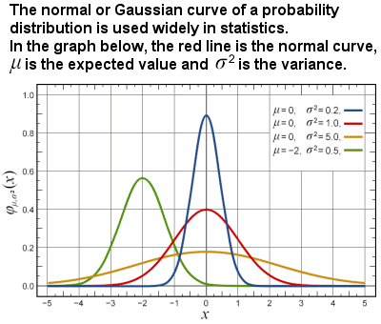
Source: http://www.storyofmathematics.com/19th_gauss.html
Back

